Slide 1
Diodes - 1

Slide 2
Outline
Linear IV characteristics.
Non-linear IV characteristics
Piecewise Linear Approximation of Non-linear circuit elements
Example 1
Example 2
Solving Circuits with Non-Linear elements: Method of Assumed States
Example 3
Example 4

Slide 3
Current-Voltage (I-V) Characteristics
I-V characteristic defines the relationship between the current flow (through), I and voltage (across), V an electronic device or element.
A tool for understanding the operation of the circuit element.
The Current-Voltage (I-V) characteristics are found by evaluating the response of a device/element under different excitation conditions. The behavior of a device depends on the applied excitation and can change if the excitation changes.

Slide 4
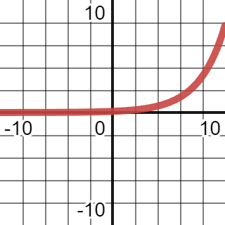
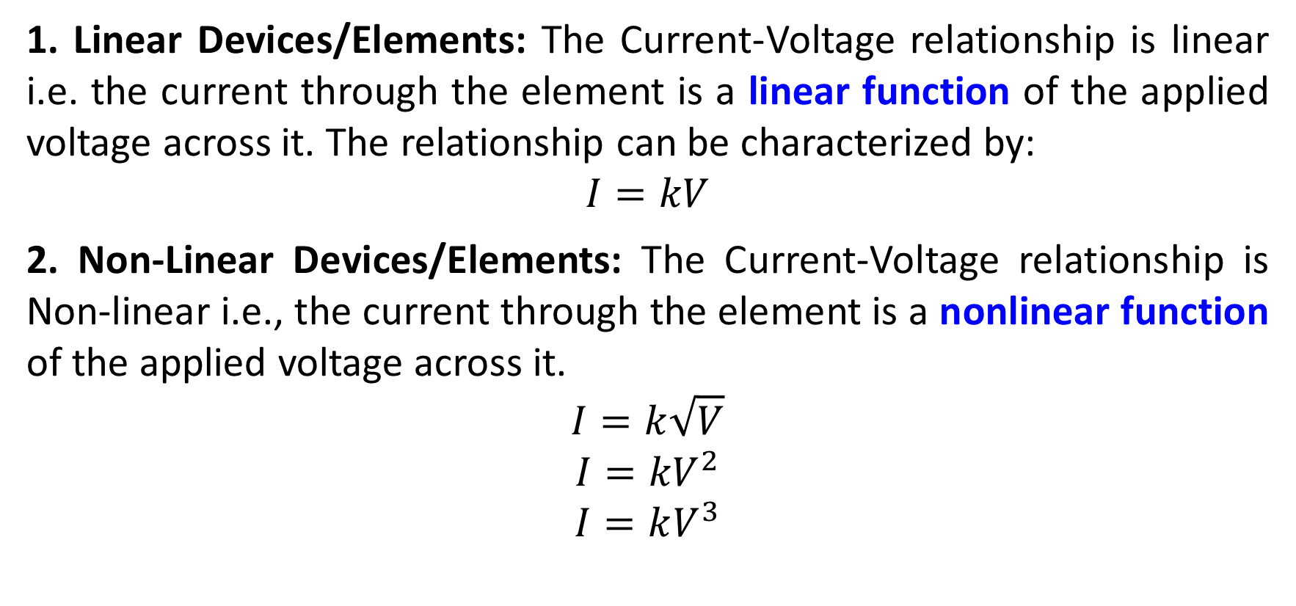
Type of (I-V) Characteristics
1. Linear Devices/Elements: The Current-Voltage relationship is linear i.e. the current through the element is a linear function of the applied voltage across it. The relationship can be characterized by:
$$I=kV$$
2. Non-Linear Devices/Elements: The Current-Voltage relationship is Non-linear i.e., the current through the element is a nonlinear function of the applied voltage across it.
$$I=k\sqrt{V}$$
$$I={kV}^{2}$$
$$I=kV^{3}$$

Slide 5
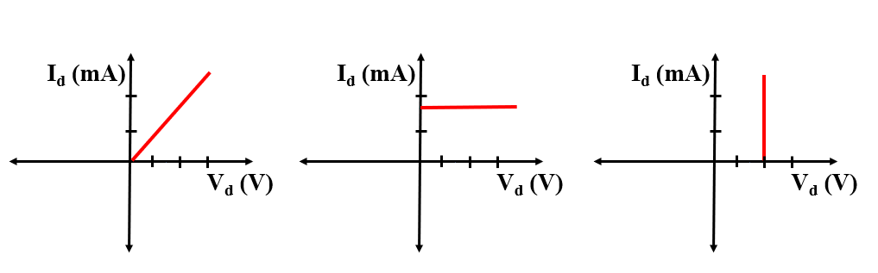
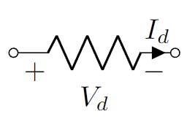
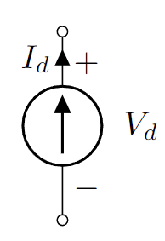
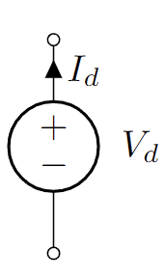
Linear IV Char.
Resistors
Current Source
Voltage Source

Slide 6
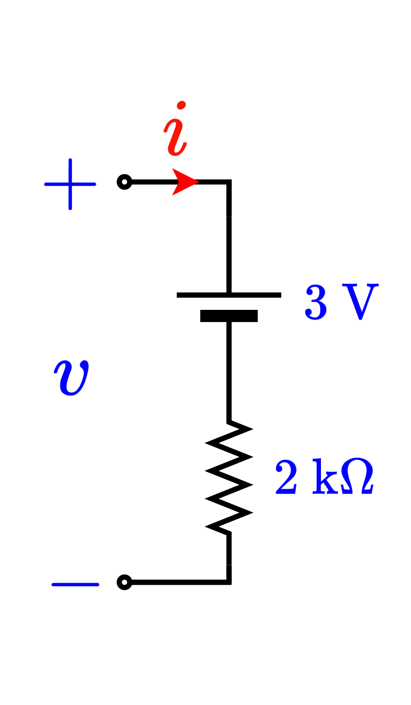
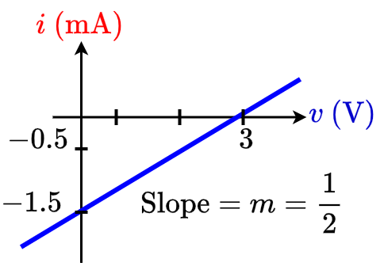
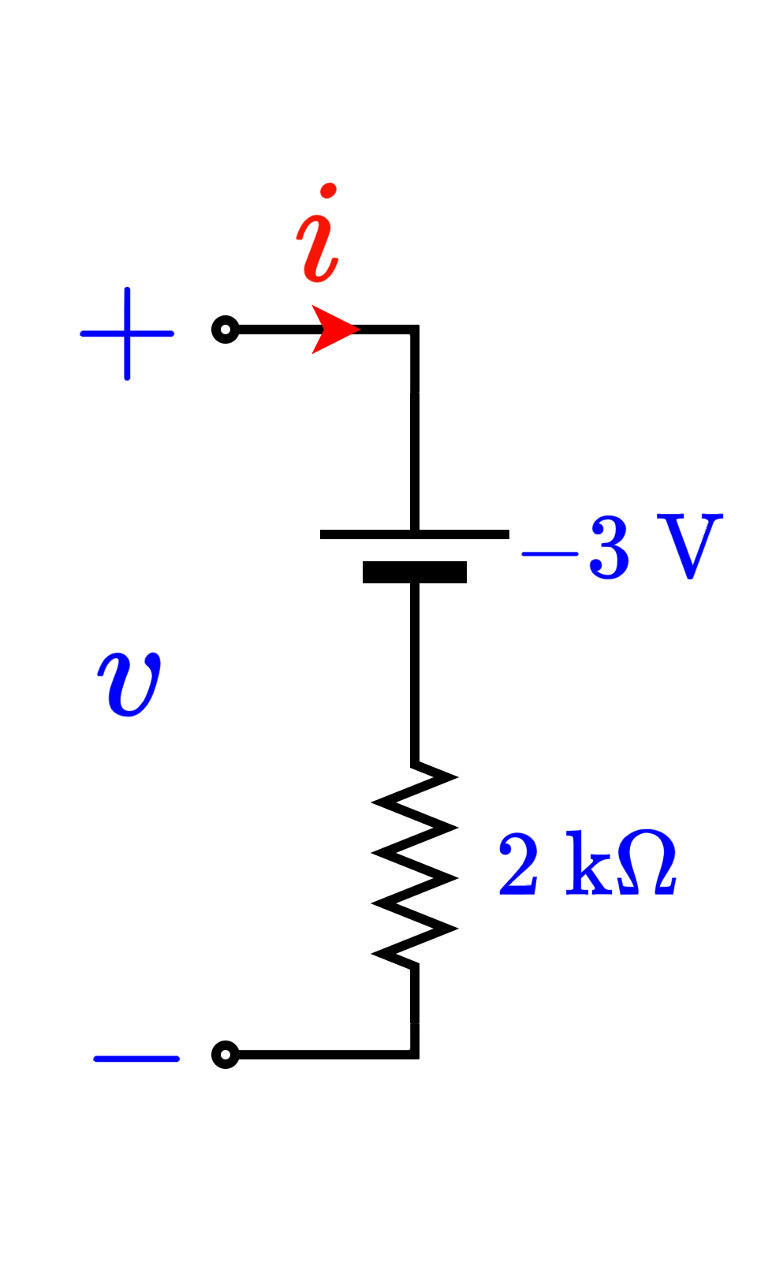
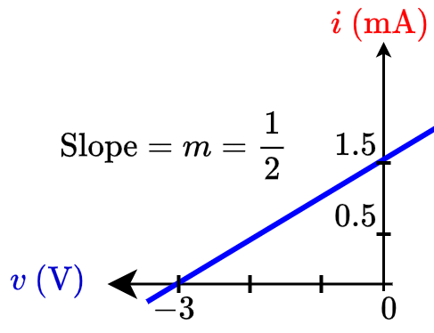
Linear IV Char.
Voltage source in series with a resistor
Voltage source in series with a resistor

Slide 7
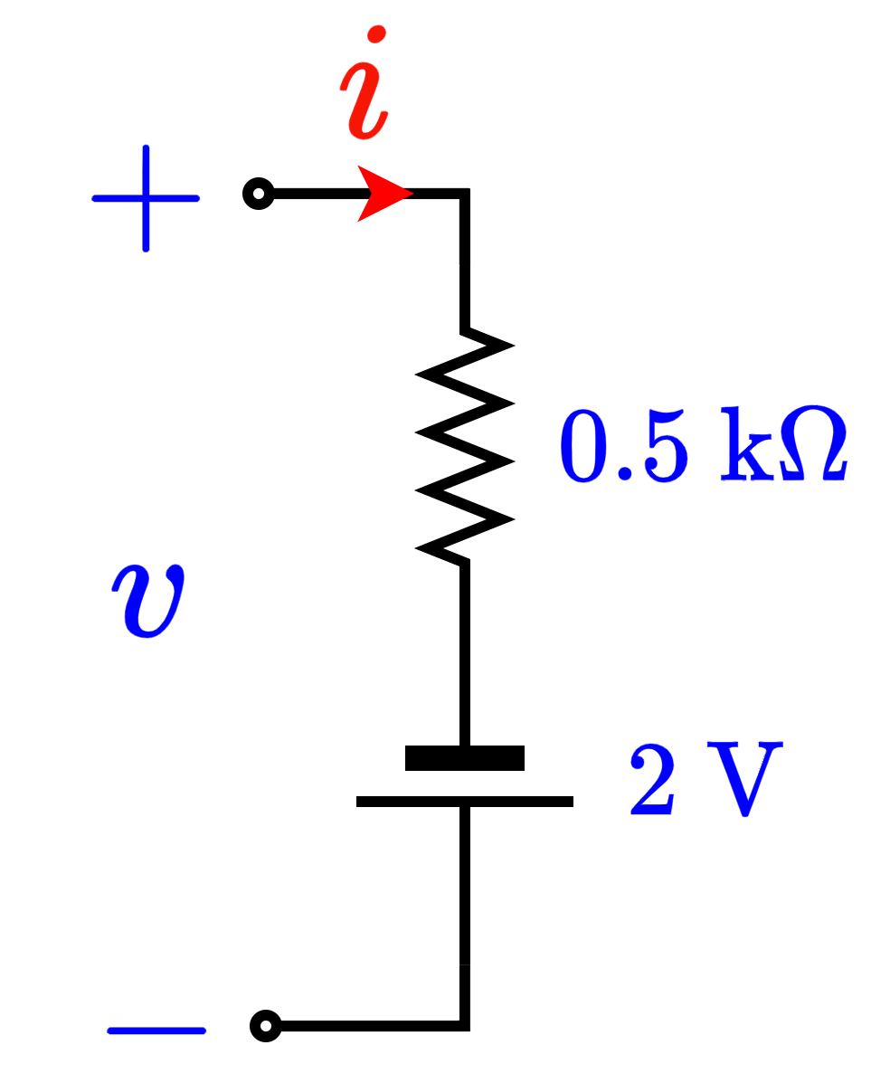
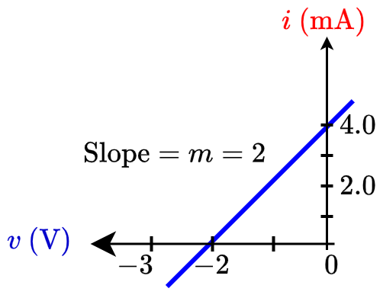
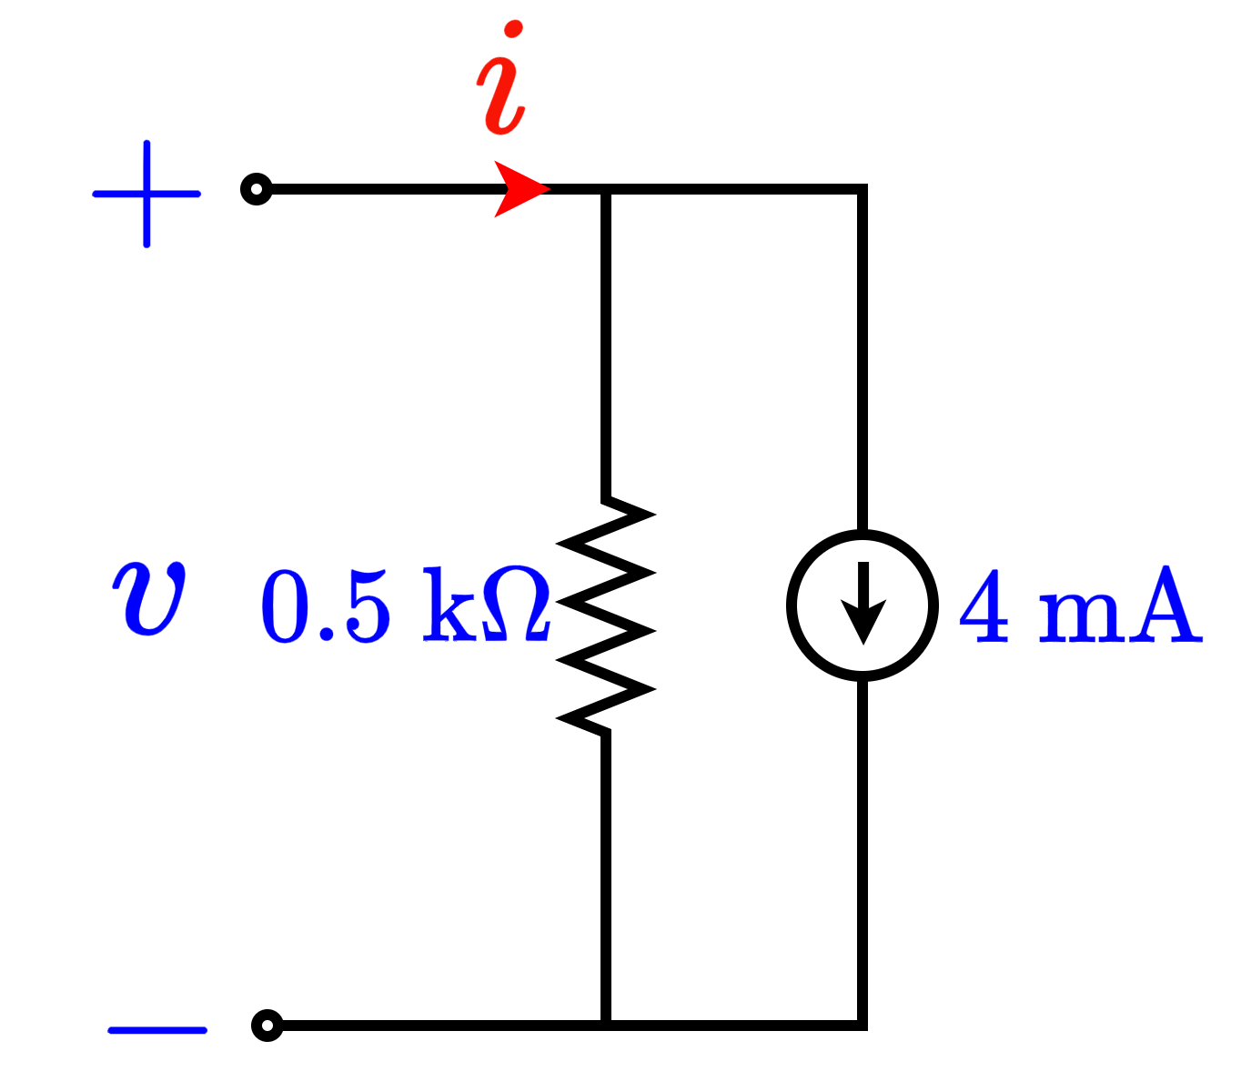
Linear IV Char.
Voltage source in series with a resistor
Current source parallel to a resistor

Slide 8
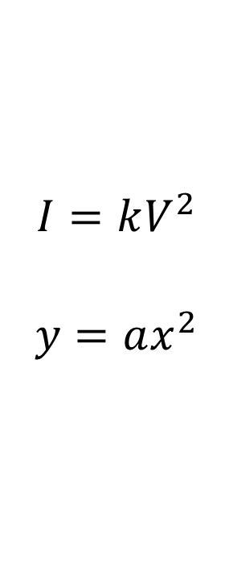
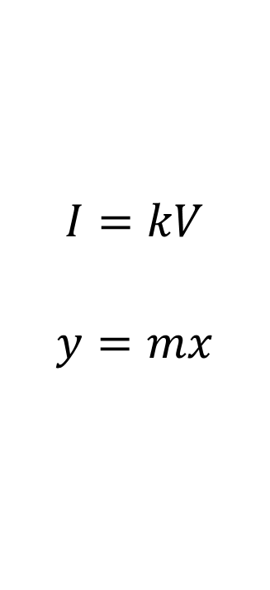
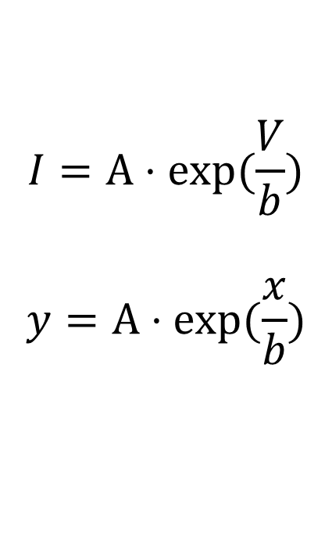
Non-Linear I-V Char.
$$I=kV$$
$$y=mx$$
$$I=kV^{2}$$
$$y=ax^{2}$$
$$I=A⋅exp⁡(\frac{V}{b})$$
$$y=A⋅exp⁡(\frac{x}{b})$$

Slide 9
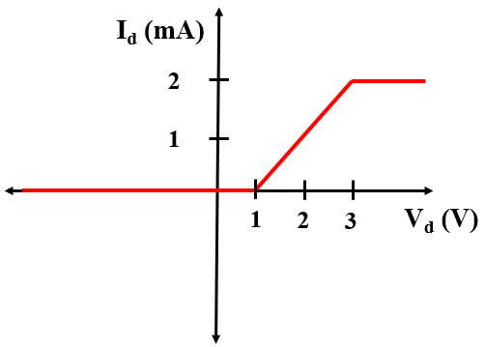
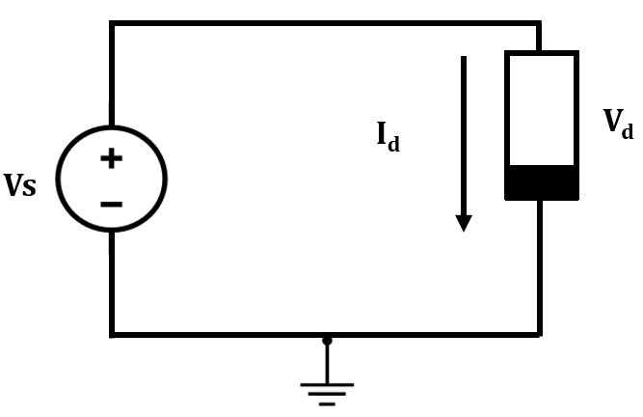
Non-Linear I-V Char.
Example:
Piecewise linear function is a Non-linear function.

Slide 10
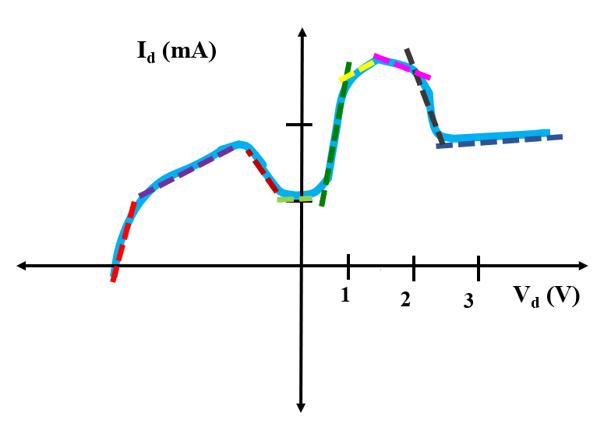
Non-Linear I-V Char.: Piecewise Linear Model
Simplifying non-linear IV characteristics by piecewise linear parts.
Non-linear functions are usually approximated by a series of linear segments that follow the tangent of the non-linear segment as can be seen from the following figure.

Slide 11
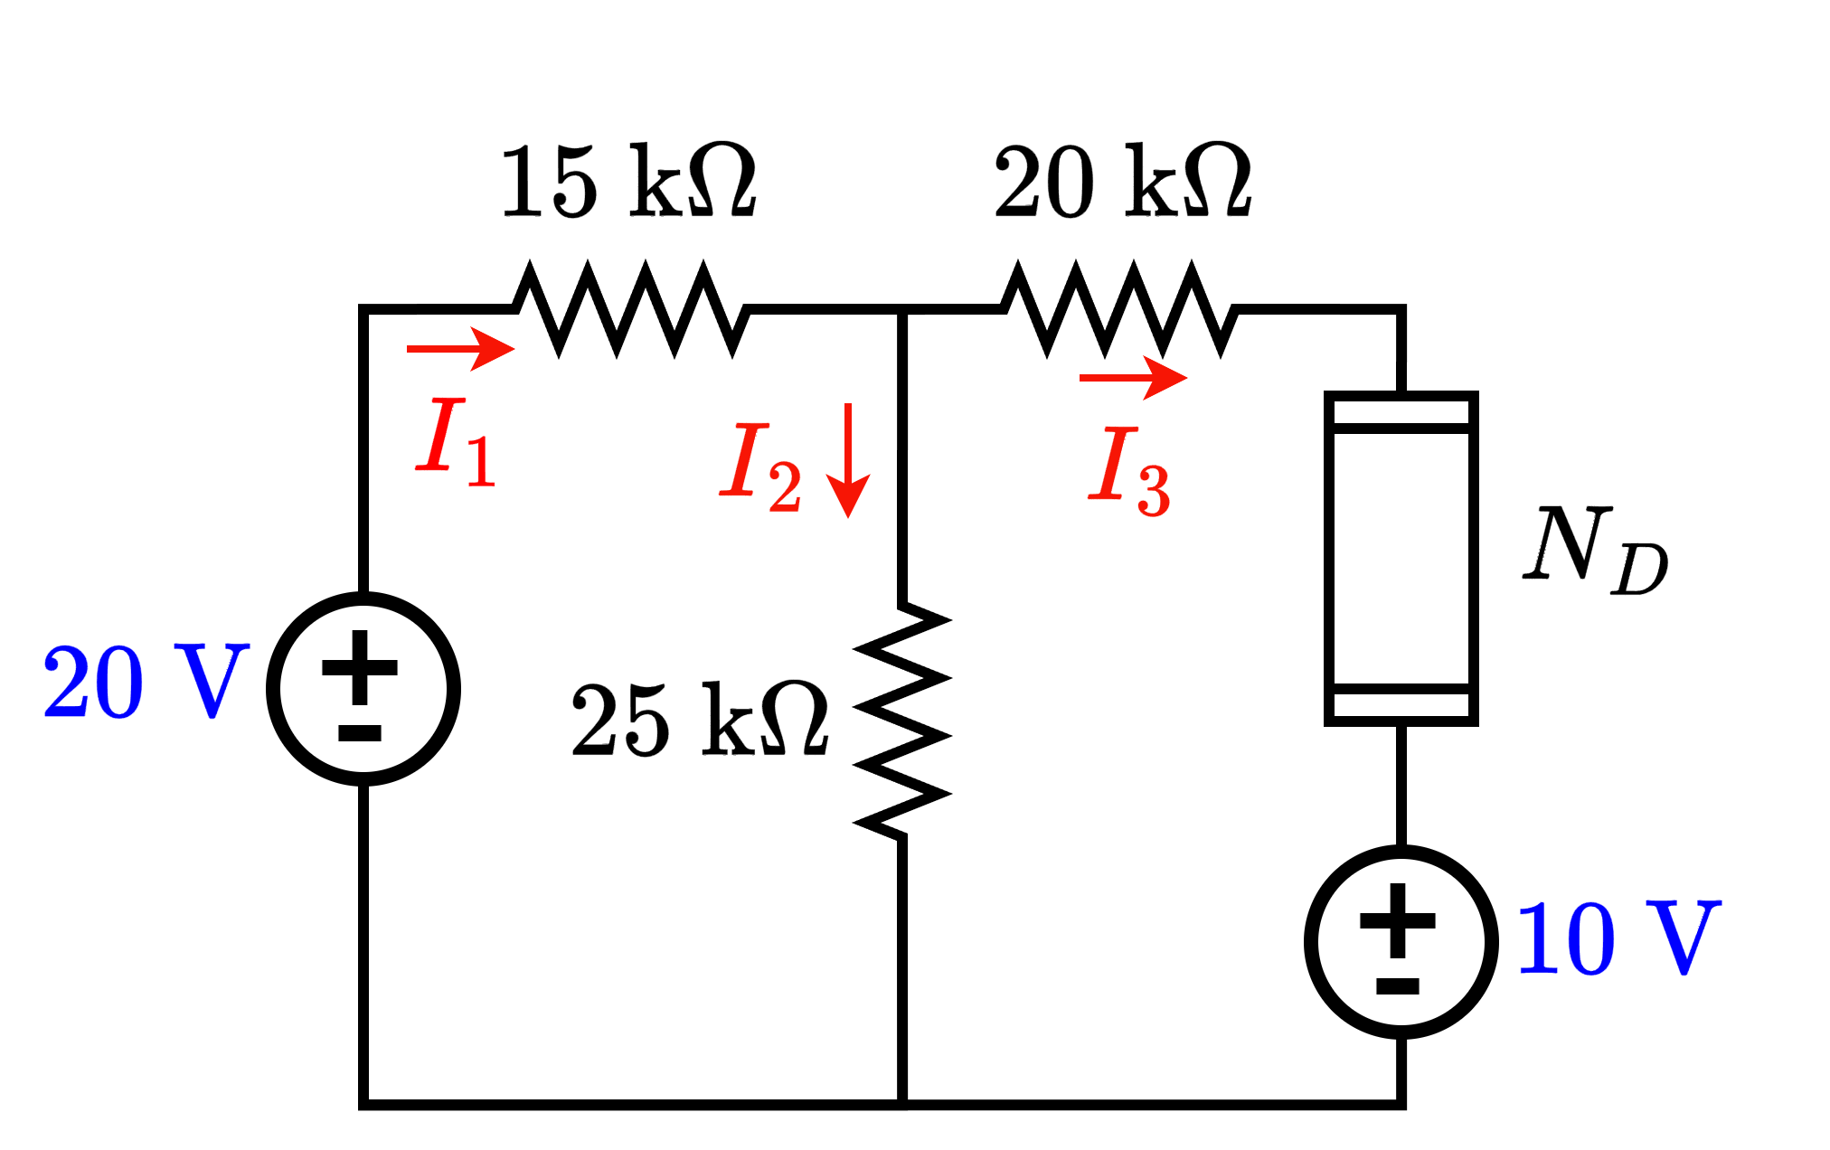
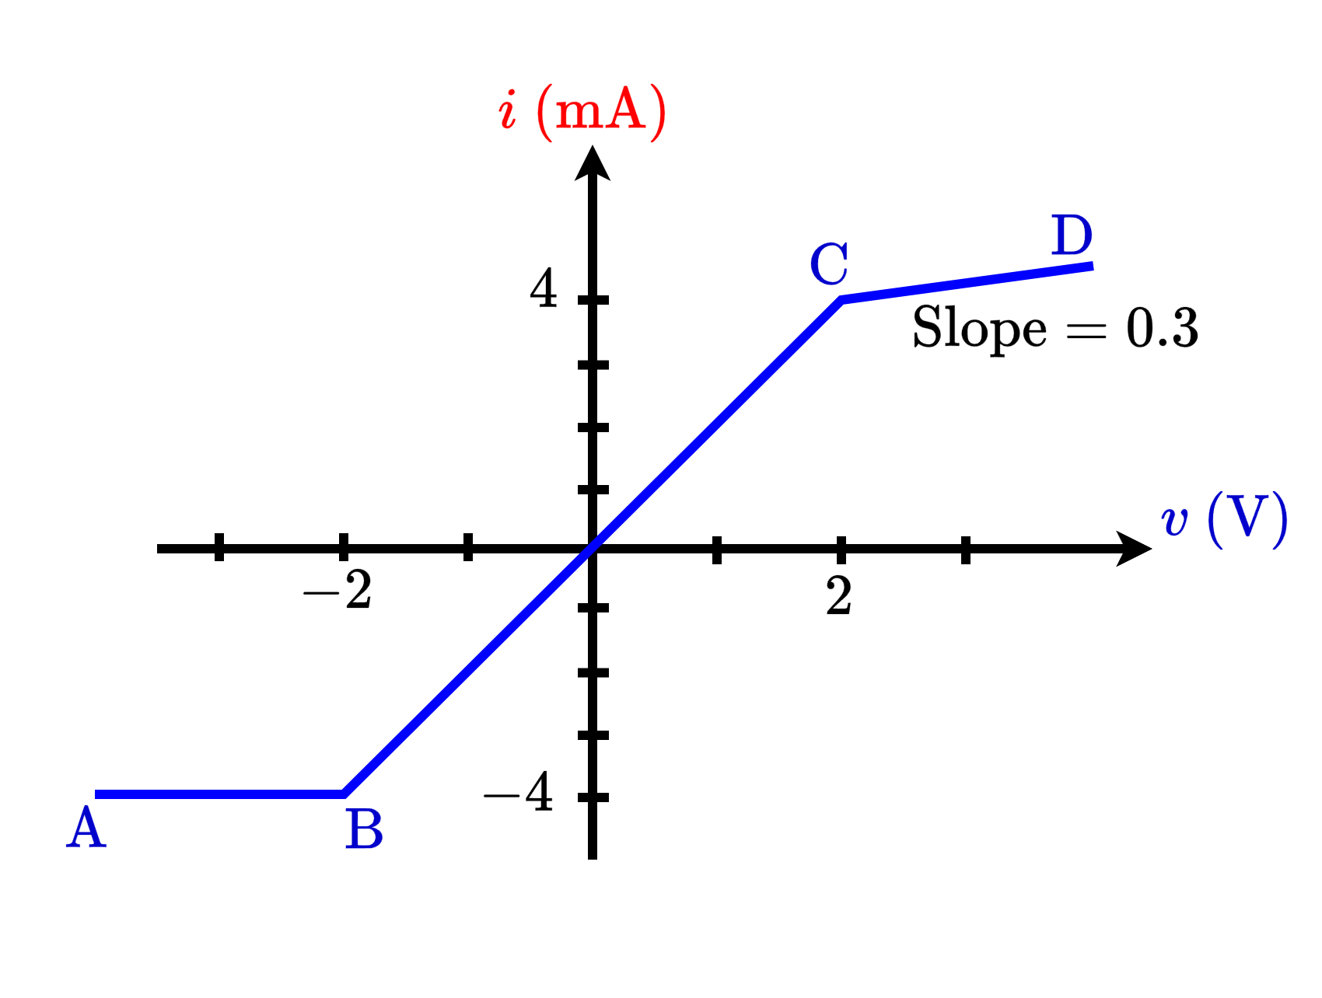
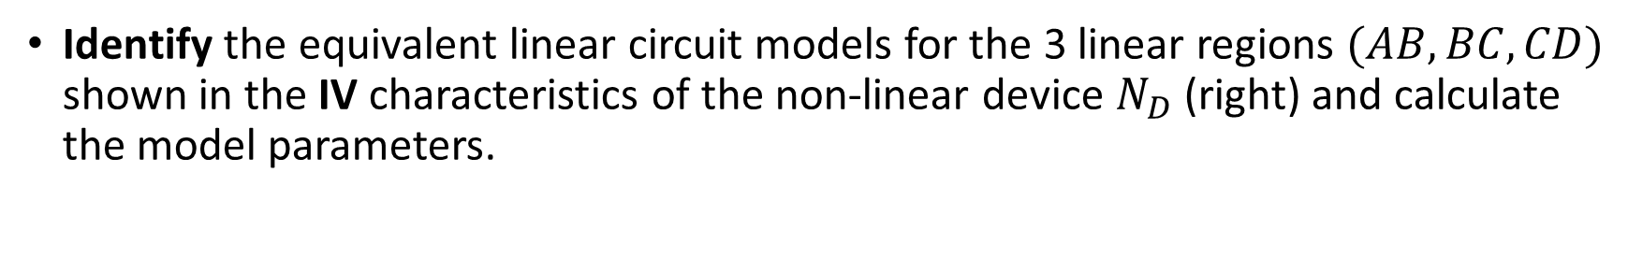
NL I-V Char.: PL Model Example 1
Identify the equivalent linear circuit models for the 3 linear regions $(AB, BC, CD)$ shown in the IV characteristics of the non-linear device $N_{D}$ (right) and calculate the model parameters.

Slide 12
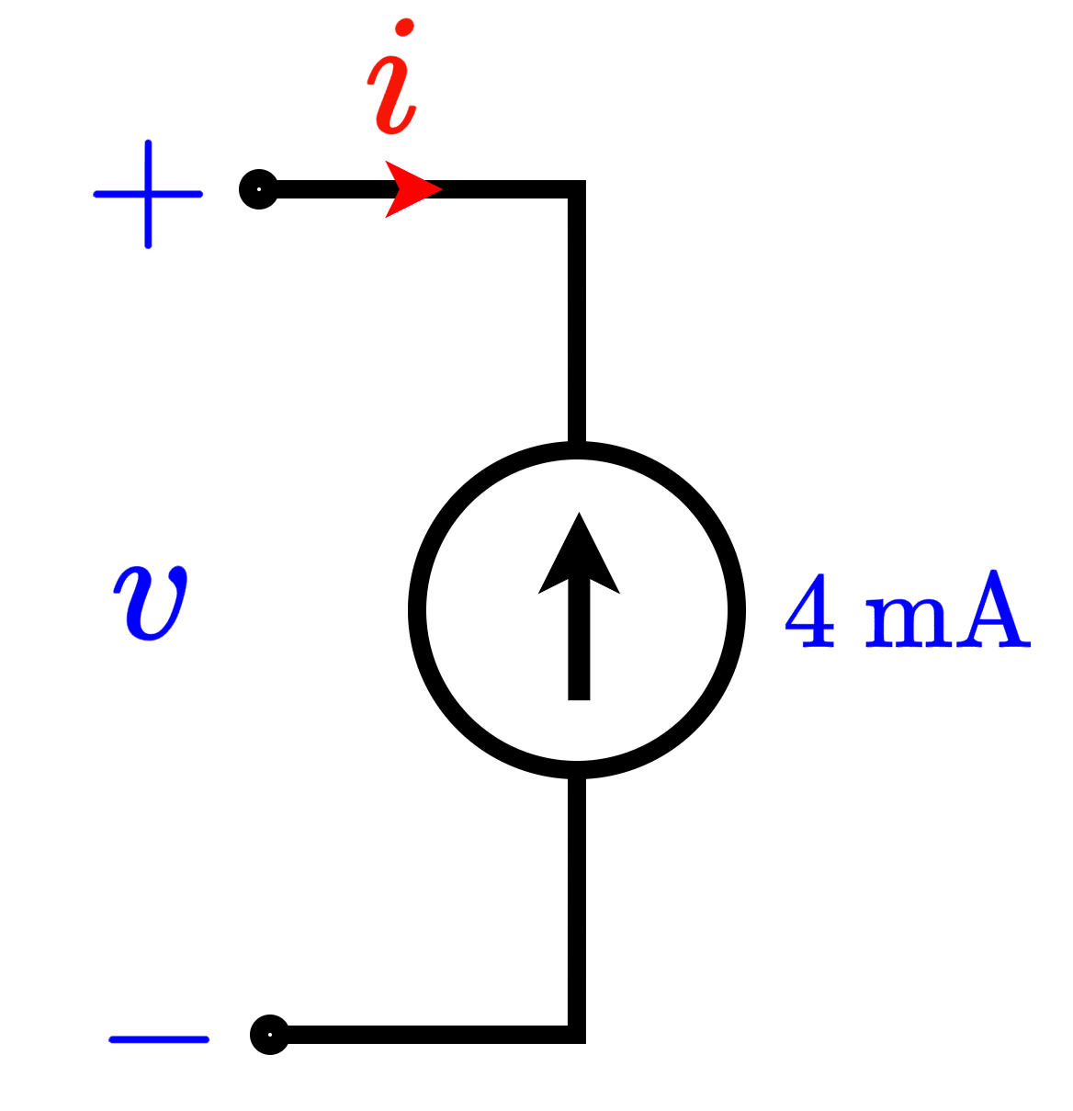
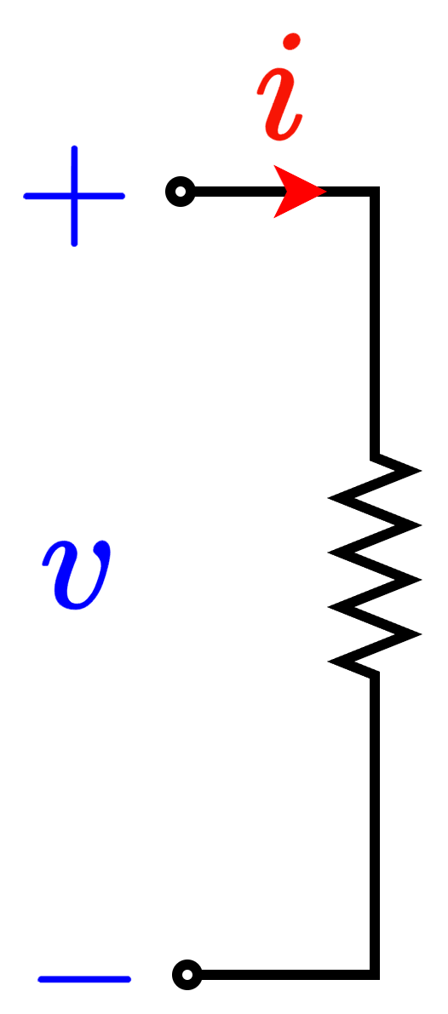
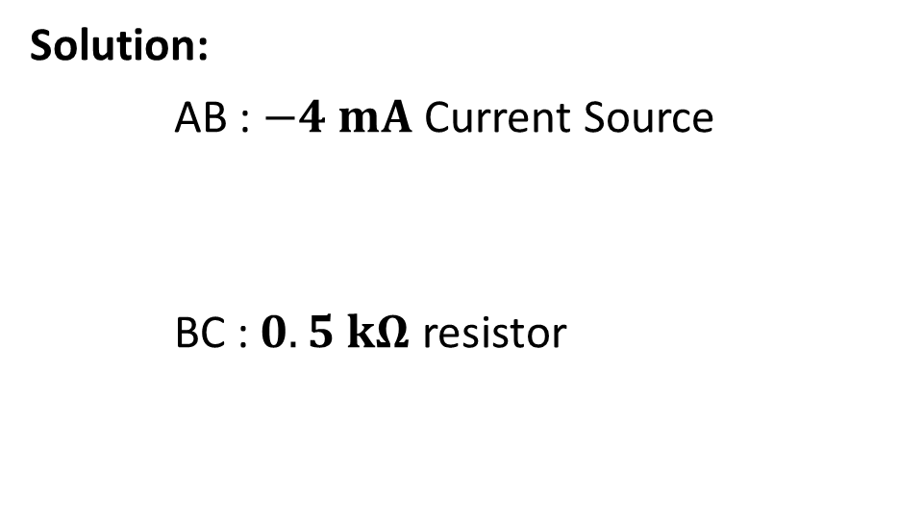
NL I-V Char.: PL Model Example 1
Identify the equivalent linear circuit models for the 3 linear regions $(AB, BC, CD)$ shown in the IV characteristics of the non-linear device $N_{D}$ (right) and calculate the model parameters.
Solution:
AB : $−4 mA$ Current Source
BC : $0.5 kΩ$ resistor

Slide 13
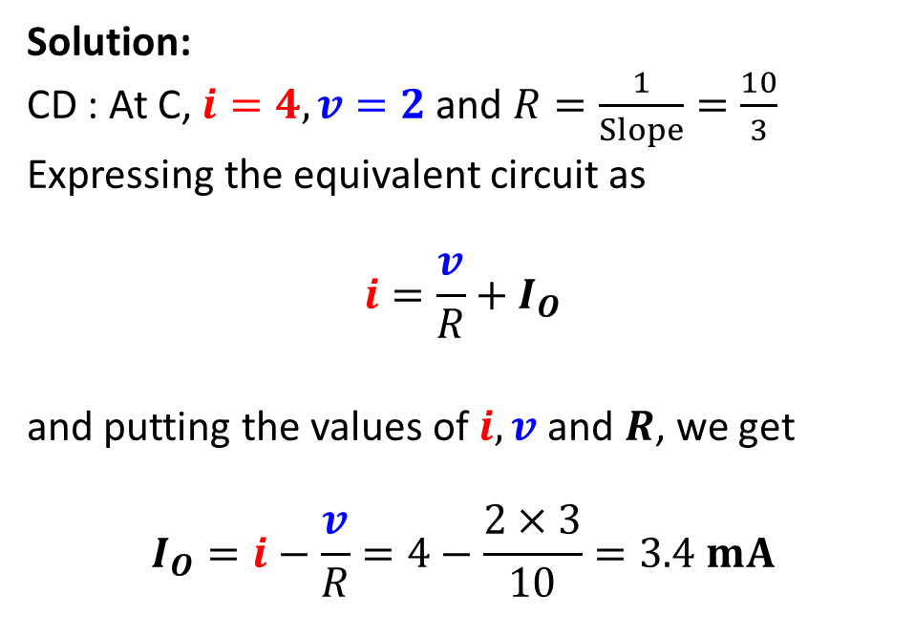
NL I-V Char.: PL Model Example 1
Identify the equivalent linear circuit models for the 3 linear regions $(AB, BC, CD)$ shown in the IV characteristics of the non-linear device $N_{D}$ (right) and calculate the model parameters.
Solution:
CD : At C, $i=4, v=2$ and $R=\frac{1}{Slope}=\frac{10}{3}$
Expressing the equivalent circuit as
$$i=\frac{v}{R}+I_{O}$$
and putting the values of $i, v$and $R$, we get
$$I_{O}=i−\frac{v}{R}=4−\frac{2×3}{10}=3.4 mA$$

Slide 14
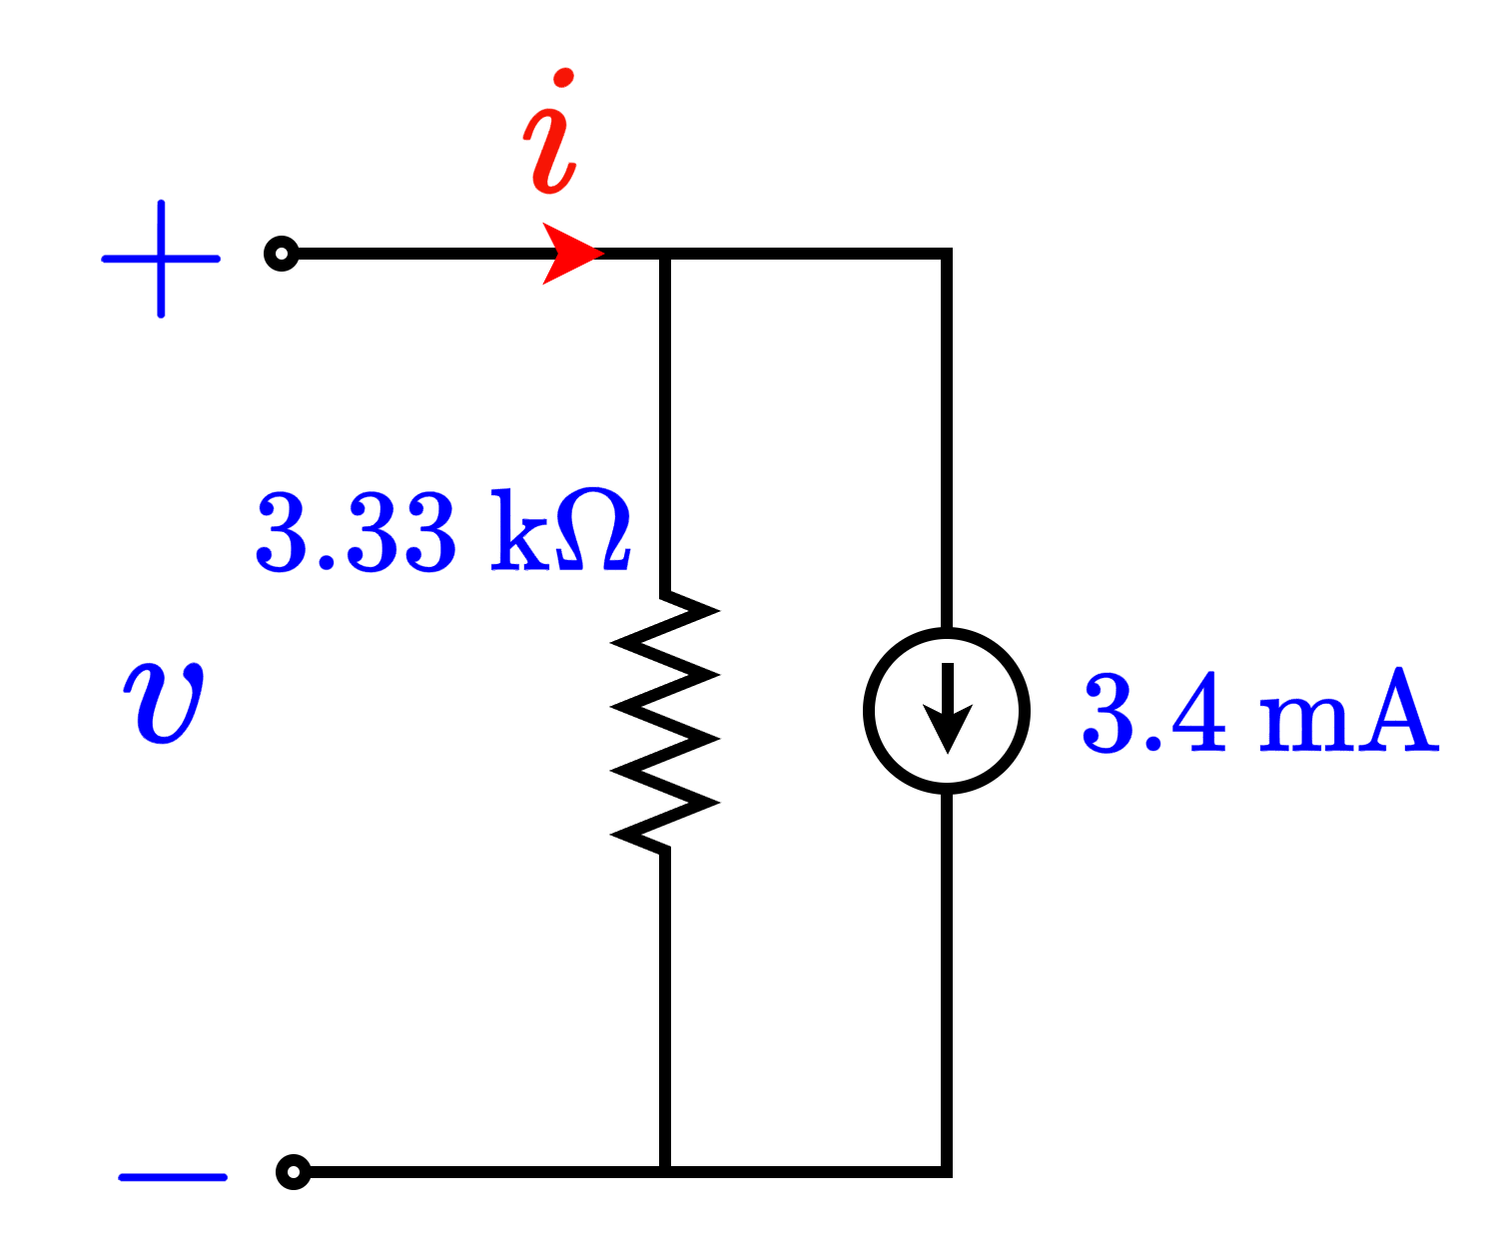
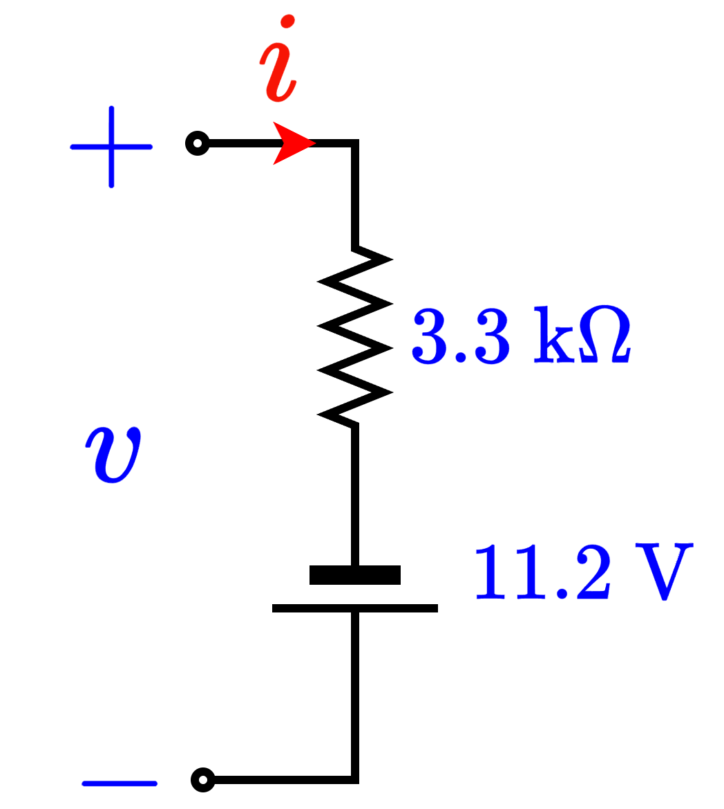

NL I-V Char.: PL Model Example 1
Identify the equivalent linear circuit models for the 3 linear regions $(AB, BC, CD)$ shown in the IV characteristics of the non-linear device $N_{D}$ (right) and calculate the model parameters.
Solution:
CD : $i=\frac{v}{3.33}+3.4$

Slide 15

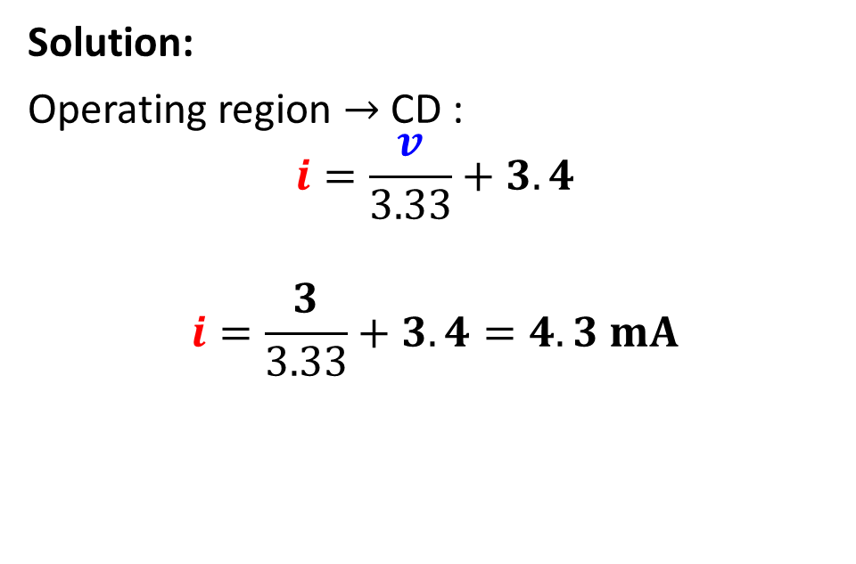
NL I-V Char.: PL Model Example 2
Detect the operating region for the device when $v= 3 V$ and calculate the current through the device, $i$, for this voltage (hint: use the IV graph and answers from previous part).
Solution:
Operating region $→$ CD :
$$i=\frac{v}{3.33}+3.4$$
$$i=\frac{3}{3.33}+3.4=4.3 mA$$

Slide 16
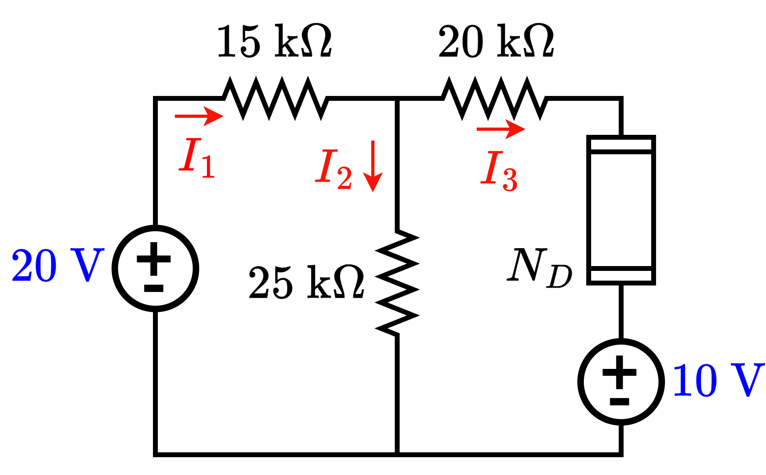

NL I-V Char.: PL Model Example 3
Solve the circuit on the left, to find the currents $I_{1}, I_{2}$ and $I_{3}$. Additionally, determine the voltage across $N_{D}$.

Slide 17
Solving Circuits with Non-Linear elements
Use Method of Assumed State!
Three steps:
Assume: One of the operating modes (AB, BC, CD)
Solve: Use corresponding equation with any circuit analysis tool
Verify: Check if the conditions of the NL device are satisfied. If not, repeat.

Slide 18
NL I-V Char.: PL Model Example 3
Solve the circuit on the left, to find the currents $I_{1}, I_{2}$ and $I_{3}$. Additionally, determine the voltage across $N_{D}$.

Slide 19
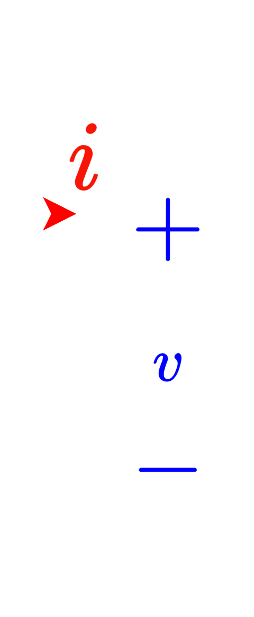
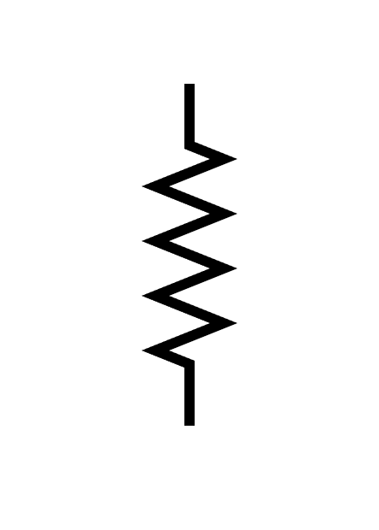
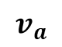
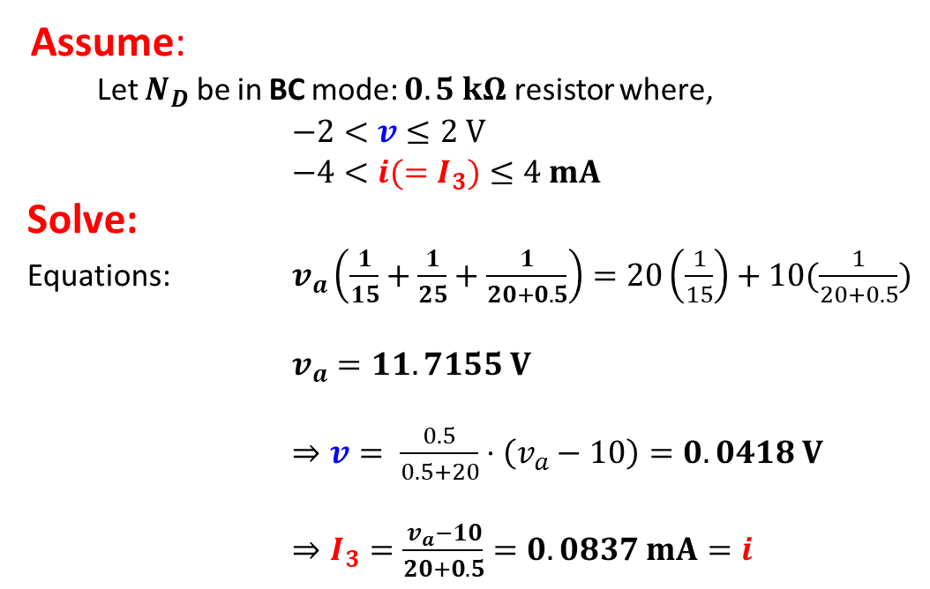
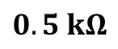
Method of Assumed State: Example 3
Solve the circuit on the right, to find the currents $I_{1}, I_{2}$ and $I_{3}$. Additionally, determine the voltage across $N_{D}$.
Assume:
Let $N_{D}$ be in BC mode: $0.5 kΩ$ resistor where,
$−2<v≤2 V$
$−4<i(=I_{3})≤4 mA$
Solve:
Equations: $v_{a}\left(\frac{1}{15}+\frac{1}{25}+\frac{1}{20+0.5}\right)=20\left(\frac{1}{15}\right)+10(\frac{1}{20+0.5})$
$v_{a}=11.7155 V$
$⇒v= \frac{0.5}{0.5+20}⋅\left(v_{a}−10\right)=0.0418 V$
$⇒I_{3}=\frac{v_{a}−10}{20+0.5}=0.0837 mA=i$
$$v_{a}$$
$0.5 kΩ$

Slide 20
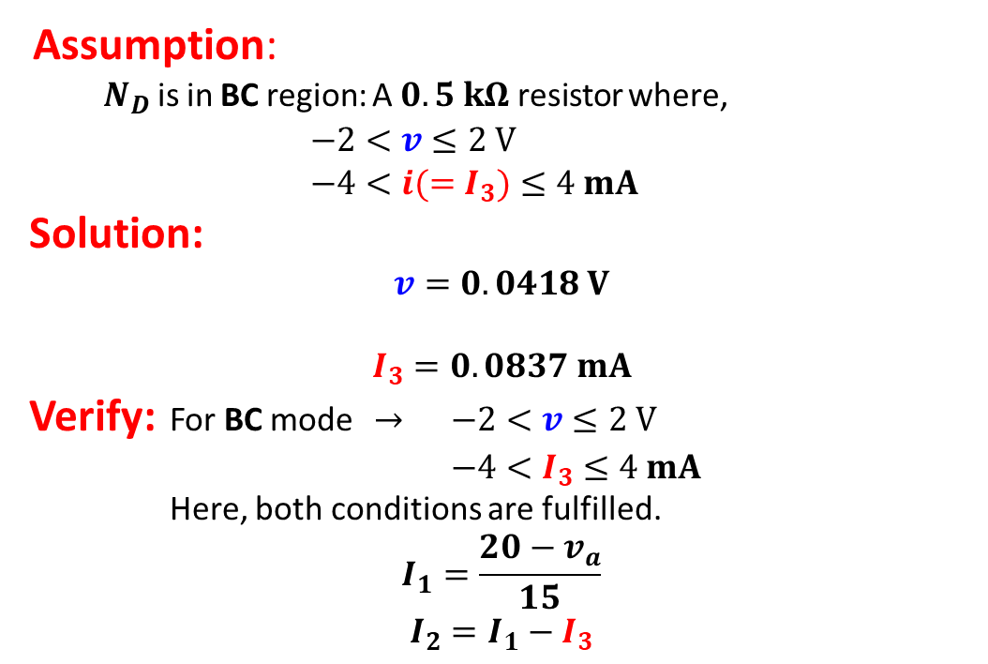
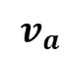
Method of Assumed State: Example 3
Solve the circuit on the right, to find the currents $I_{1}, I_{2}$ and $I_{3}$. Additionally, determine the voltage across $N_{D}$.
Assumption:
$N_{D}$ is in BC region: A $0.5 kΩ$ resistor where,
$−2<v≤2 V$
$−4<i(=I_{3})≤4 mA$
Solution:
$$v=0.0418 V$$
$$I_{3}=0.0837 mA$$
Verify: For BC mode $→$ $−2<v≤2 V$
$−4<I_{3}≤4 mA$
Here, both conditions are fulfilled.
$$I_{1}=\frac{20−v_{a}}{15}$$
$$I_{2}=I_{1}−I_{3}$$
$$v_{a}$$
Assumption is Correct!

Slide 21
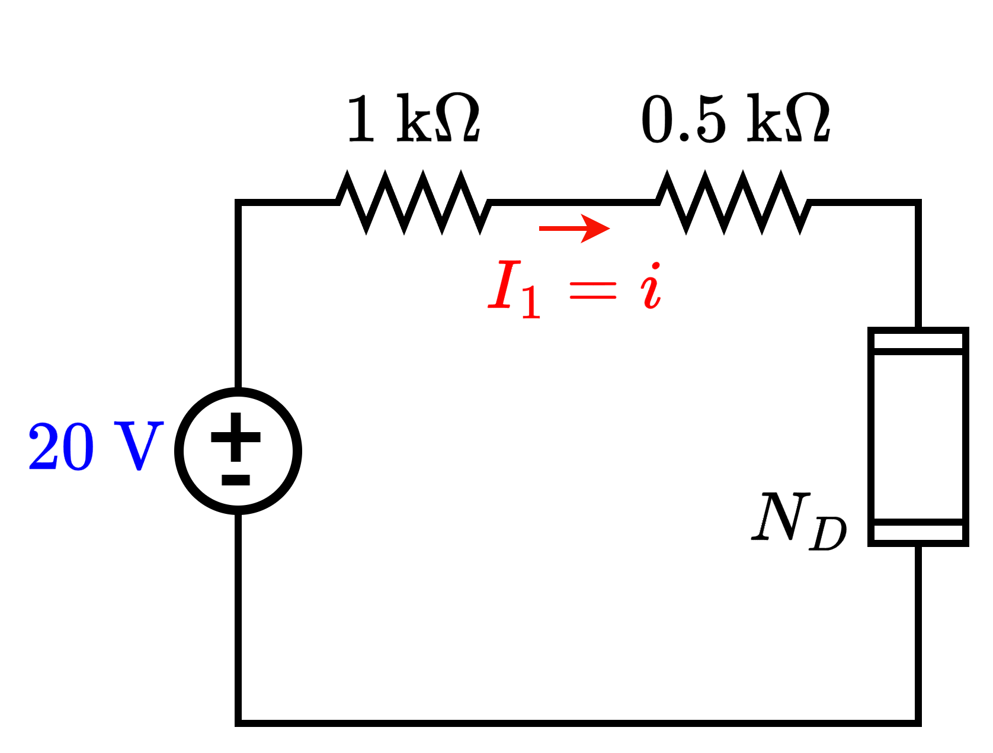

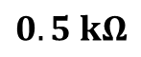
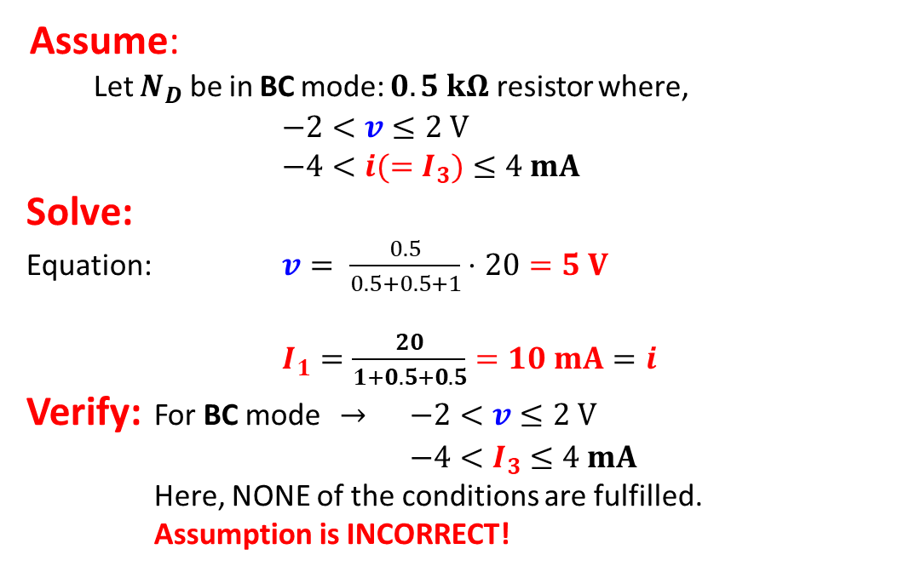
Method of Assumed State: Example 4
Solve the circuit on the right, to find the currents $I_{1}$. Additionally, determine the voltage across $N_{D}$.
Assume:
Let $N_{D}$ be in BC mode: $0.5 kΩ$ resistor where,
$−2<v≤2 V$
$−4<i(=I_{3})≤4 mA$
Solve:
Equation: $v= \frac{0.5}{0.5+0.5+1}⋅20=5 V$
$I_{1}=\frac{20}{1+0.5+0.5}=10 mA=i$
Verify: For BC mode $→$ $−2<v≤2 V$
$−4<I_{3}≤4 mA$
Here, NONE of the conditions are fulfilled.
Assumption is INCORRECT!
$0.5 kΩ$

Slide 22
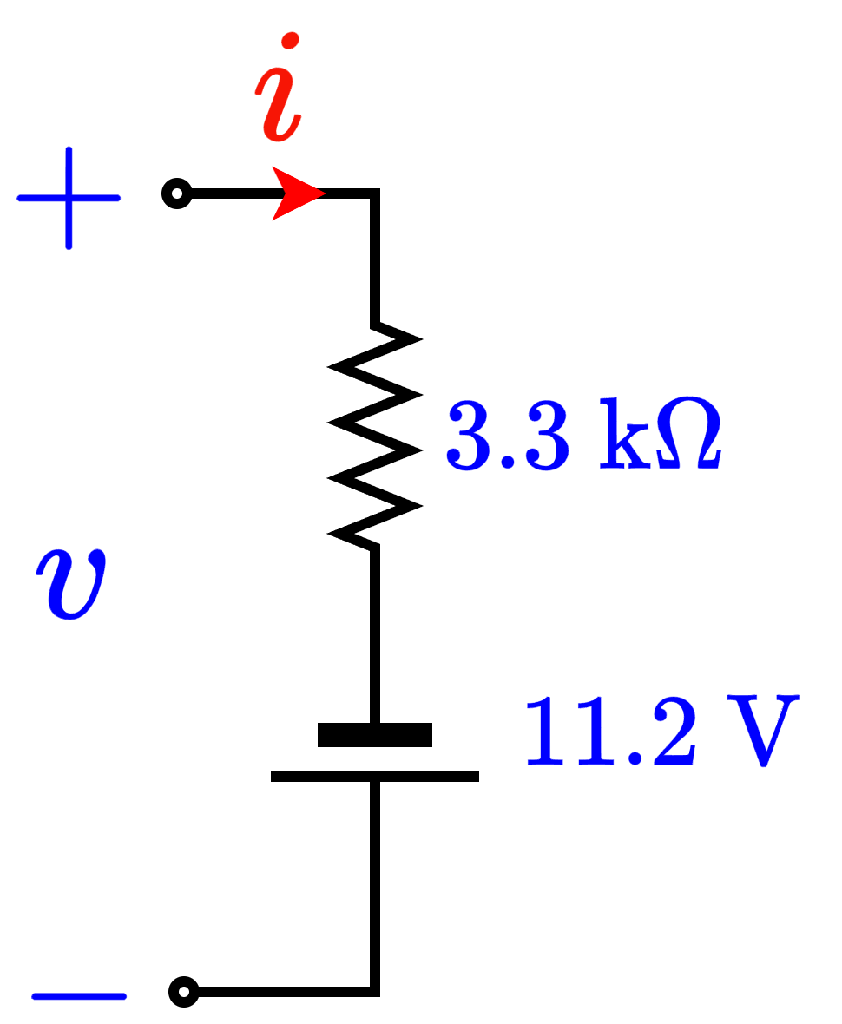
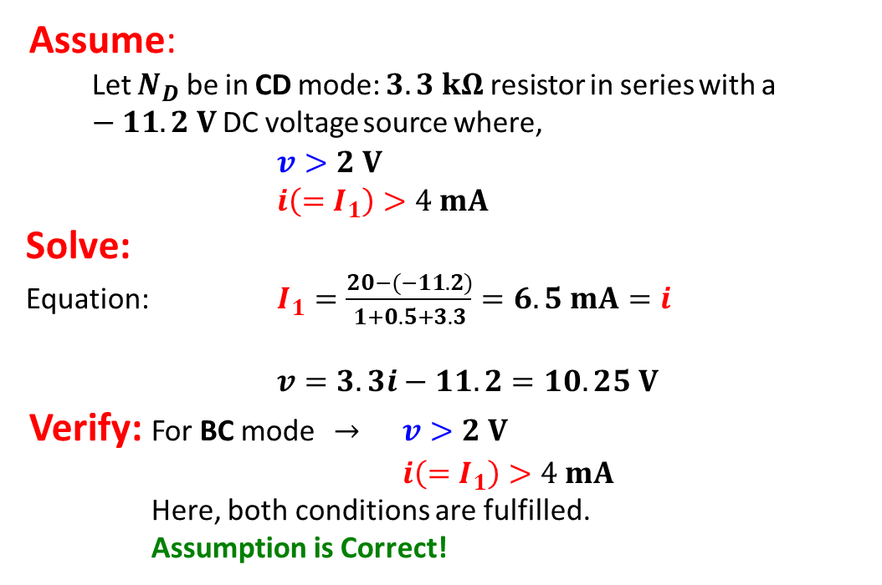
Method of Assumed State: Example 4
Solve the circuit on the right, to find the currents $I_{1}$. Additionally, determine the voltage across $N_{D}$.
Assume:
Let $N_{D}$ be in CD mode: $3.3 kΩ$ resistor in series with a $−11.2 V$ DC voltage source where,
$v>2 V$
$i\left(=I_{1}\right)>4 mA$
Solve:
Equation: $I_{1}=\frac{20−(−11.2)}{1+0.5+3.3}=6.5 mA=i$
$v=3.3i−11.2=10.25 V$
Verify: For BC mode $→$ $v>2 V$
$i\left(=I_{1}\right)>4 mA$
Here, both conditions are fulfilled.
Assumption is Correct!

Slide 23
Part 1 ends here

Slide 24
Outline
Semiconductor Materials
n-type
p-type
Semiconductor Devices: pn junction Diode
Physical Characteristics
Modes of Operation

Slide 25
Semiconductor Materials
Semiconductors are special class of materials (as opposed to conductors and insulators) that fall between conductors and insulators in terms of their electrical conductivity.
By making simple material changes, such as doping, these materials can achieve remarkably precise control over electron flow.
This ability to control electron flow makes semiconductors the optimal candidate for building non-linear electrical devices, where electron (current) flow is not always just proportional to the applied voltage.
As these non-linear devices offer exceptional control over electron flow, the class of devices and circuits are branched under the umbrella term “Electronics”

Slide 26
Semiconductor Materials
What is doping?
Doping is to deliberately inject atomic level “impurities” into a material (such as an “intrinsic” or pure semiconductor such as Silicon. These atoms are called dopants.
Usually, the concentration of the “dopant” atoms is much less than the actual concentration of the host material.
Since the atoms being injected are different from the actual material atom, they are considered impurities. A doped semiconductor is also known as “Extrinsic” semiconductor.

Slide 27
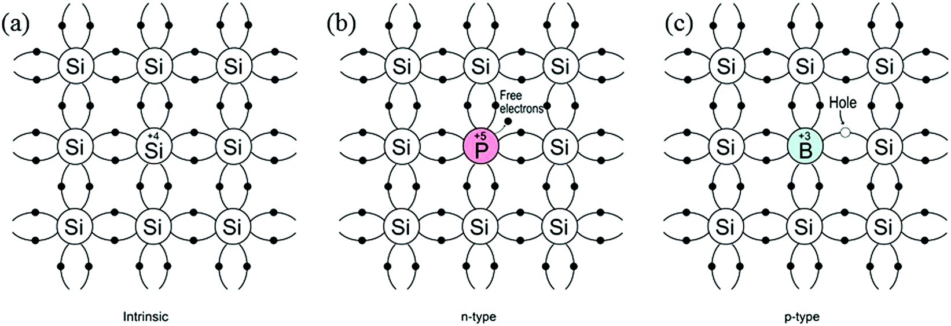
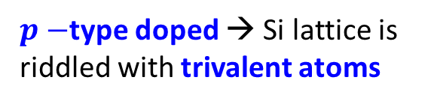
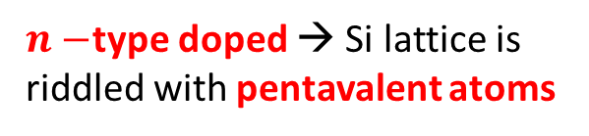
Semiconductor Materials
$n−$type doped → Si lattice is riddled with pentavalent atoms
$p−$type doped → Si lattice is riddled with trivalent atoms

Slide 28
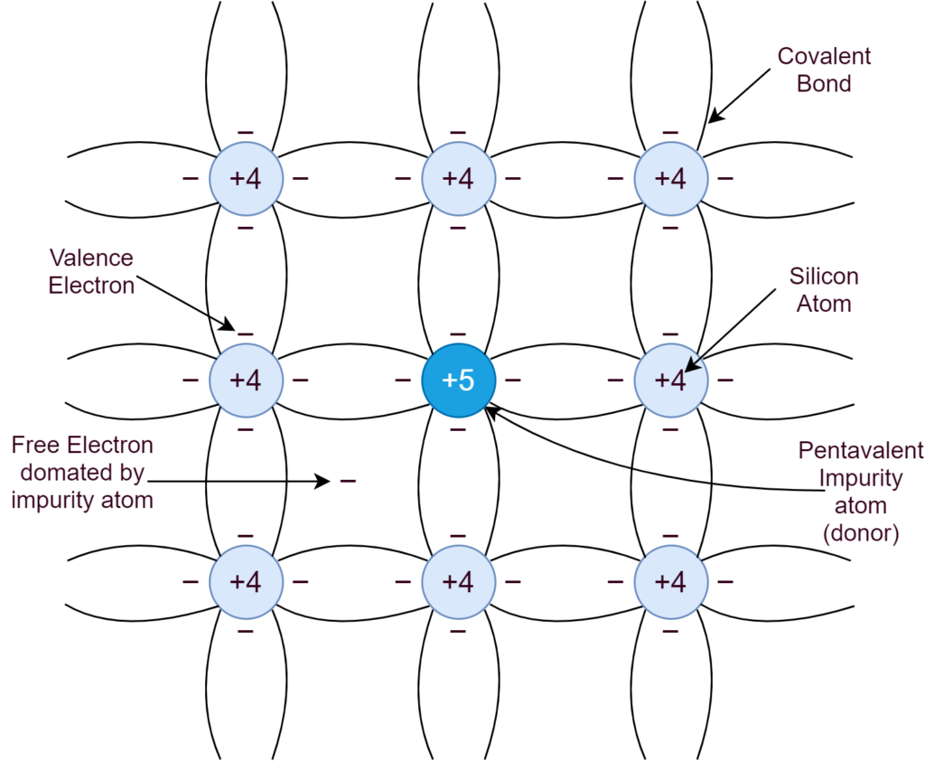
n-type doping
n-type materials are doped with pentavalent atoms.
Pentavalent atoms have one more electron than the surrounding tetravalent Si atoms.
This lone extra electron acts as a mobile electron that can flow easily as it is not bonded to any atom.

Slide 29
p-type doping
p-type materials are doped with trivalent atoms.
Trivalent atoms have one less electron than the surrounding tetravalent Si atoms.
This absence of an electron (termed as a hole) acts as can flow easily from atom to atom across the material as it is not bonded to any atom. The flow of holes is opposite to the actual flow of electrons.

Slide 30
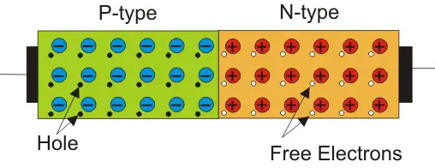
Semiconductor Devices: Diode
Diode is the most basic semiconductor device.
It is made by doping an intrinsic semiconductor (Si) half as p-type and the other half as n-type.

Slide 31
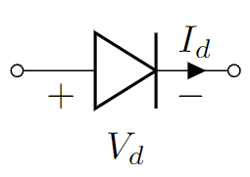
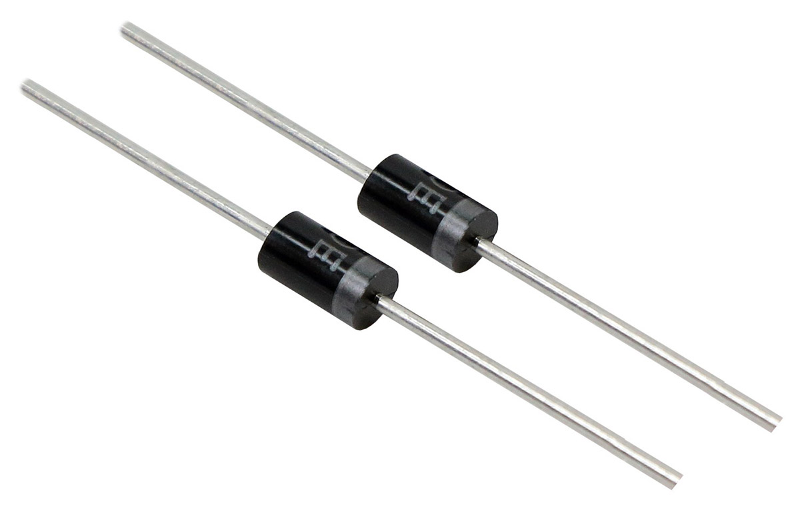
The pn junction diode: Physical characteristics
Internal Structure
Circuit Schematic
Real device image
Anode
Cathode

Slide 32
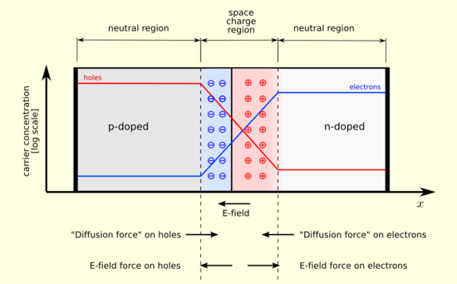
The pn junction diode: Physical characteristics
The depletion region:
This is the region in a pn-junction device sandwiched between the n-doped and p-doped regions.
In n-doped region, mobile electrons dominate charge flow. In p-type, holes dominate.
In a pn-junction depletion regions form naturally, as charge carriers (holes in p-type and electrons in n-type) near the pn junction boundary seep into each other.

Slide 33
The pn junction diode: Physical characteristics
The depletion region:
In a pn-junction depletion regions form naturally, as charge carriers (holes in p-type and electrons in n-type) near the pn junction boundary seep into each other.
Electrons from n-type region flow into p-type region while holes flow into n-type region from p-type region.
This mutual overflow into the opposite region, creates a space charge barrier, (like that in a capacitor).

Slide 34


The pn junction diode: Modes of operation
P
n
Reverse Bias
No Bias
Forward Bias
P
n
P
n
Depletion Region

Slide 35

The pn junction diode: 2 Modes of operation
Forward Bias (FB):
Depletion Region is constricted.
Allow electrons to flow through the junction
Ideally acts as a short circuit
Reverse Bias (RB):
Depletion Region is expanded.
Bars / does not allow electron flow through the junction.
Ideally acts as an open circuit

Slide 36
Part 2 ends here

Slide 37
Outline
pn junction Diode IV Characteristics: Circuit Model
Ideal Diode Model:
Constant Voltage Drop (CVD) Model:
Constant Voltage Drop with Resistor (CVD+R) Model
Exponential Model (Shockley Model):
Examples: 6

Slide 38


Diode Circuit Models
Ideal Versus Real Diode
Constant Voltage Drop (CVD) Model
Ideal Model
Real / Shockley Model
Low Accuracy
Increased Accuracy
CVD with resistance (CVD+R) Model
Simple
More Complex

Slide 39




Diode Circuit Models
}
Ideal Diode Model:
Constant Voltage Drop (CVD) Model:
Constant Voltage Drop with Resistor (CVD+R) Model
Exponential Model (Shockley Model):
Piecewise Linear IV Models
$v_{D}$: Total Voltage Across diode
$v_{d}$: AC component of the Voltage
$V_{d}$: DC component of Voltage
--------------------------------------------
$V_{Do}$: Diode Cut-off voltage
--------------------------------------------
$i_{D}$: Total current through diode (Anode to Cathode)

Slide 40






Diode Models
Ideal Diode Model:
$$I_{D}(mA)$$
Forward Bias
$$i_{D}=0$$
$$v_{D}<0$$
$$i_{D}>0$$
$$v_{D}=0$$
$V_{Do}=0$V
$$v_{D}(V)$$
Reverse Bias

Slide 41
Solving Circuits with Diodes
Use Method of Assumed State!
Three steps:
Assume: One of the two operating modes (Forward Biased – FB or Reverse Biased - RB) *Correct assumptions will make solving circuit easier.
Solve: Use corresponding equation and KCL/KVL or any circuit analysis tool of your choice.
Verify: Check if the conditions of the diodes in the chosen region (FB or RB) are satisfied. If not, one can be sure that the other operating mode is correct.

Slide 42








Example Problems (Ideal Diode)
Example 1: $R_{L}=2.5 kΩ$
$$+ v_{d} −$$
Assume:
Diode is in FB: A short circuit,
$v_{d}=0 V$
$I>0 mA$
Solve:
$$v_{O}=v_{IN}= 5 V$$
$$v_{d}=v_{IN}−v_{O}=0 V$$
$$I=\frac{v_{O}}{R_{L}}=\frac{5 V}{2.5 kΩ}= 2 mA>0$$
Verify: For FB $→$ $v_{d}=0 V$
$I>0 mA$
Here, both conditions are fulfilled. Assumption is Correct!
$$v_{IN}=5 V$$
$$+ v_{d}=0 −$$
$$v_{IN}=5 V$$

Slide 43









Example Problems (Ideal Diode)
Example 2: $R_{L}=2.5 kΩ$
$$− v_{d} +$$
Assume:
Diode is in FB: A short circuit,
$v_{d}=0 V$
$I>0 mA$
Solve:
$$v_{O}=v_{IN}= 5 V$$
$$v_{d}=v_{O}−v_{IN}=0 V$$
$$I=−\frac{v_{O}}{R_{L}}=−\frac{5 V}{2.5 kΩ}=− 2 mA<0$$
Verify: For FB $→$ $v_{d}=0 V$
$I>0 mA$
Here, $I<0 mA$. Assumption is INCORRECT!
$$v_{IN}=5 V$$
$$− v_{d}=0 +$$
$$v_{IN}=5 V$$
$$I=−2 mA$$
$$v_{O}=5 V$$

Slide 44





Example Problems (Ideal Diode)
Example 2: $R_{L}=2.5 kΩ$
$$− v_{d} +$$
Assume:
Diode is in RB: An open circuit,
$v_{d}<0 V$
$I=0 mA$
Solve:
$$v_{O}=0 V$$
$$v_{d}=v_{O}−v_{IN}=−5 V<0 V$$
$$I=0 mA$$
$$v_{IN}=5 V$$
$$− v_{d}=−5 V +$$
$$v_{IN}=5 V$$
$$I=0 mA$$
$$v_{O}=0 V$$

Slide 45









Diode Models
$$I_{D}(mA)$$
2. Constant Voltage Drop (CVD) Model:
Reverse Bias
Forward Bias
$V_{Do}=0.3$V
$$v_{D}(V)$$
$$i_{D}=0$$
$$v_{D}<V_{Do}$$
$$i_{D}>0$$
$$v_{D}=V_{Do}$$
$v_{D}$: Total Voltage Across diode
--------------------------------------------
$V_{Do}$: Diode Cut-off voltage (0.3 V here)

Slide 46




Diode Models
$$I_{D}(mA)$$
2. Constant Voltage Drop (CVD) Model:
Reverse Bias
Forward Bias
$$y=0$$
$$v_{D}=V_{Do}$$
$V_{Do}=0.3$V
$$v_{D}(V)$$
$$x=V_{Do}$$
$v_{D}$: Total Voltage Across diode
--------------------------------------------
$V_{Do}$: Diode Cut-off voltage (0.3 V here)

Slide 47




Example Problems (CVD Diode)
Example 3: $R_{L}=2.5 kΩ$
$$+ v_{d} −$$
Assume:
Diode is in FB: A constant voltage source of $V_{DO}$ voltage,
$v_{d}=V_{DO}=0.7 V$
$I>0 mA$
Solve:
$$v_{O}=v_{IN}−V_{DO}= 5−0.7 V=4.3 V$$
$$v_{d}=V_{DO}=0.7 V$$
$$I=\frac{v_{IN}−V_{DO}}{R_{L}}=\frac{4.3 V}{2.5 kΩ}=1.72 mA>0$$
Verify: For FB $→$ $I>0 mA$
Here, both conditions are fulfilled. Assumption is Correct!
$$v_{IN}=5 V$$
$$v_{IN}=5 V$$

Slide 48





Example Problems (CVD Diode)
Example 4: $R_{L}=2.5 kΩ$
$$+ v_{d}−$$
Assume:
Diode is in FB: A constant voltage source of $V_{DO}$ voltage,
$v_{d}=V_{DO}=0.7 V$
$I>0 mA$
Solve:
$$v_{O}=v_{IN}−V_{DO}=0.4−0.7 V=−0.3 V$$
$$I=\frac{v_{O}}{R_{L}}=\frac{−0.3 V}{2.5 kΩ}=−0.12 mA<0$$
Verify: For FB $→$ $I>0 mA$
Here, $I<0 mA$. Assumption is INCORRECT!
$$v_{IN}=0.4 V$$
$$v_{IN}=0.4 V$$

Slide 49




Example Problems (Ideal Diode)
Example 4: $R_{L}=2.5 kΩ$
$$+ v_{d}−$$
Assume:
Diode is in RB: An open circuit,
$v_{d}<V_{DO}=$ 0.7 V
$I=0 mA$
Solve:
$$I=0 mA$$
$$v_{O}=0 V$$
$$v_{d}=v_{IN}−v_{O}=0.4 V<0.7 V$$
$$v_{IN}=0.4 V$$
$$+ v_{d}=0.4 V−$$
$$v_{IN}=0.4 V$$

Slide 50







Diode Models
3. CVD+R Model:
$$I_{d}(mA)$$
Reverse Bias
Forward Bias
$V_{Do}=0.7$V
$$v_{D}(V)$$
$v_{D}$: Total Voltage Across diode
--------------------------------------------
$V_{Do}$: Diode Cut-off voltage (0.7 V)

Slide 51






Diode Models
3. CVD+R Model:
$$I_{d}(mA)$$
Reverse Bias
Forward Bias
$$y=0$$
$V_{Do}=0.7$V
$$v_{D}(V)$$
$$x=V_{Do}+y⋅\frac{1}{m}$$
$v_{D}$: Total Voltage Across diode
--------------------------------------------
$V_{Do}$: Diode Cut-off voltage (0.7 V)

Slide 52



Example Problems (CVD+R Diode)
Example 5: $R_{L}=2.5 kΩ$, $V_{DO}=0.7 V, r_{d}=50 Ω$
$$+ v_{d} −$$
Assume:
Diode is in FB: A constant voltage drop in series with a resistor,
$V_{DO}=0.7 V$, $r_{d}=50 Ω$
$v_{d}=V_{DO}+Ir_{d}$
$I>0 mA$
Solve:
$$I=\frac{v_{O}−V_{DO}}{R_{L}+r_{d}}=\frac{4.3 V}{2.5 kΩ+0.05 kΩ}=1.70 mA$$
$$v_{O}=IR_{L}= 1.70×2.5 V=4.25 V$$
Verify: For FB $→$ $I>0 mA$
Here, the condition is fulfilled. Assumption is Correct!
$$v_{IN}=5 V$$
$$v_{IN}=5 V$$

Slide 53




Example Problems (CVD+R Diode)
Example 6: $R_{L}=2.5 kΩ$, $V_{DO}=0.7 V, r_{d}=50 Ω$
$$+ v_{d} −$$
Assume:
Diode is in RB: An open circuit,
$v_{d}<V_{DO}$
$I=0 mA$
Solve:
$$v_{O}=0 V$$
$$v_{d}=v_{IN}−v_{O}=0.3 V$$
Verify: For FB $→$ $v_{d}<V_{DO}$
Here, the condition is fulfilled. Assumption is Correct!
$$v_{IN}=0.3 V$$
$$+ v_{d}=0.3 V−$$
$$v_{IN}=0.3 V$$

Slide 54








Diode Models
3. CVD+R Model:
Forward Bias
$$I_{d}(mA)$$
$$x=V_{Do}+y⋅\frac{1}{m}$$
Reverse Bias
$$y={m⋅x −m⋅V}_{Do}$$
$$y=0$$
$V_{Do}=0.7$V
$$v_{D}(V)$$

Slide 55




Diode Models
$$I_{D}(mA)$$
4. Shockley Diode Equation Model:
$$v_{D}(V)$$
Where I_{S} is reverse saturation current

Slide 56



Diode Models: Summary
Ideal Diode
CVD Diode
$$i_{D}>0$$
Forward Bias
$$v_{D}<V_{DO}$$
$$i_{D}=0$$
Reverse Bias

Slide 57



Diode Models: Summary
CVD+R Diode
$$i_{D}>0$$
Forward Bias
$$v_{D}<V_{DO}$$
$$i_{D}=0$$
Reverse Bias

Slide 58
Part 3 ends here

Slide 59
Outline
Practice Problems

Slide 60


Solving Circuits with diodes (7)
If $v_{I}=5 V$ and$V_{DO}=0.7 V$, find $v_{O}$

Slide 61

Solving Circuits with diodes (7)
i) If $v_{I}=5 V$ , $V_{S}=10 V$ and$V_{DO}=0.7 V$, find $v_{O}$
ii) If $v_{I}=11 V$ , $V_{S}=10 V$ and$V_{DO}=0.7 V$, find $v_{O}$
iii) If $v_{I}=0 V$ , $V_{S}=10 V$ and$V_{DO}=0.7 V$, find $v_{O}$

Slide 62

Solving Circuits with diodes (9)
Example 9: Analyze the circuit to find $I_{D1}, I_{D2}, v_{x}$ and $v_{y}$. Consider $V_{DO}=0.5 V$. [Validate Assumptions]

Slide 63




Solving Circuits with diodes (9)
Example 9: Analyze the circuit to find $I_{D1}, I_{D2}, v_{x}$ and $v_{y}$. Consider $V_{DO}=0.5 V$. [Validate Assumptions]
Assume:
D1, D2 are in FB: A constant voltage source of $V_{DO}$ voltage,
$v_{D1}=0.5 V$, || $v_{D2}=0.5 V$
$I_{D1}>0 mA$, || $I_{D2}>0 mA$
Solve:
$$v_{x}=5.5−v_{D1}=5 V$$
$$v_{y}=10.5−v_{D2}=10 V$$
$$I_{D1}=\frac{v_{x}−v_{y}}{R_{1}}=\frac{−5 V}{3 kΩ}=−1.66 mA<0$$
$$I_{D2}=\frac{v_{y}}{R_{1}}−I_{D1}=\frac{10}{2}−\frac{−5 }{3 }=\frac{20}{3} mA>0$$
Verify: $I_{D1}>0 mA$, || $I_{D2}>0 mA$
Here,$I_{D1}<0 mA$. Assumption is INCORRECT!
$$+ v_{D1}−$$
$${−v}_{D2}+$$

Slide 64



Solving Circuits with diodes (9)
Example 9: Analyze the circuit to find $I_{D1}, I_{D2}, v_{x}$ and $v_{y}$. Consider $V_{DO}=0.5 V$. [Validate Assumptions]
Assume:
D1 in RB D2 are in FB
$I_{D1}=0 mA$, || $v_{D2}=0.5 V$
$v_{D1}<0.5 V$, || $I_{D2}>0 mA$
Solve:
$$v_{y}=10.5−v_{D2}=10 V$$
$$v_{x}=v_{y}=10 V, as I_{D1}=0$$
$$v_{D1}=5.5 −v_{x}=−4.5 V<0.5 V$$
$$I_{D2}=\frac{v_{y}}{R_{1}}=\frac{10}{2}=5 mA>0$$
Verify: $v_{D1}<0.5 V$, || $I_{D2}>0 mA$
Assumption is Correct!
$$+ v_{D1}−$$
$${−v}_{D2}+$$
$$+ v_{D1}−$$

Slide 65

Solving Circuits with diodes (10)
Example 10: Analyze the circuit to find $I_{D1}, I_{D2}, v_{x}$ and $v_{y}$. Consider $V_{DO}=1 V$. [Validate Assumptions]. Are the diodes consuming power or delivering power?

Slide 66




Solving Circuits with diodes (11)
Example 10: Analyze the circuit to find $I_{D1}$, $I_{D2}$, $v_{x}$ and $v_{y}$. Consider $V_{DO}=1 V$. [Validate Assumptions]. Are the diodes consuming power or delivering power?
Assume:
D1, D2 are in FB: A constant voltage source of $V_{DO}$ voltage,
$v_{D1}=1 V$, || $v_{D2}=1 V$
$I_{D1}>0 mA$, || $I_{D2}>0 mA$
Solve:
$$v_{x}=v_{D1}=1 V$$
$$v_{y}=v_{x}+v_{D2}=2 V$$
$$I_{D2}=\frac{{12−v}_{y}}{R_{2}}=\frac{10}{2}=5 mA>0$$
$$I_{D1}=I_{D2}+\frac{9−v_{x}}{R_{1}}=5+\frac{8}{2}=9 mA>0$$
Verify: $I_{D1}>0 mA$, || $I_{D2}>0 mA$
Assumption is Correct!
$${−v}_{D2}+$$
$$+$$
$${ v}_{D1}$$
$$−$$

Slide 67


Solving Circuits with diodes (12)
Analyze the circuit to find $I_{D1}, I_{D2}, I_{D3}$ and $I$ for the following cases: Consider $V_{DO}=0.6 V$. $r_{d}=50 Ω$ [Validate Assumptions]
$$V_{1}=0 V, V_{2}=2 V$$
$$V_{1}=V_{2}=0 V$$
$$V_{1}=V_{2}=5 V$$
$$V_{1}=5 V, V_{2}=0 V$$

Slide 68
Solving Circuits with diodes (12)
Analyze the circuit to find $I_{D1}, I_{D2}, I_{D3}$ and $I$ for the following cases: Consider $V_{DO}=0.6 V$. $r_{d}=50 Ω$ [Validate Assumptions]
$$V_{1}=0 V, V_{2}=2 V$$
$$V_{1}=V_{2}=0 V$$
$$V_{1}=V_{2}=5 V$$
$$V_{1}=5 V, V_{2}=0 V$$

Slide 69

Solving Circuits with diodes (12)
Analyze the circuit to find $I_{D1}, I_{D2}, I_{D3}$ and $I$ for the following cases: Consider $V_{DO}=0.6 V$. $X=9.5$ [Validate Assumptions]
$$V_{1}=V_{2}=0 V$$
$$V_{1}=V_{2}=5 V$$
$$V_{1}=5 V, V_{2}=0 V$$
$$V_{1}=0 V, V_{2}=2 V$$
For what value of X, will D3 be in cut-off?
X

Slide 70


Solving Circuits with diodes (13)
Analyze the circuit to find $I_{1}, I_{2},$ and $v_{O}$ for
Assuming all diodes as ideal
Consider $V_{D1}=0.5 V$ and $V_{D2}=0.7 V$. (CVD model)
Consider $V_{DO}=0.6 V$ and $r_{d}=50 Ω$. (CVD+R model)
[Validate Assumptions]

Slide 71


Solving Circuits with diodes (14)
Analyze the circuit to find $I_{1}, I_{2},$ and $v_{O}$ for
Assuming all diodes as ideal
Consider $V_{DO}=0.6 V$. (CVD model)
Consider $V_{DO}=0.6 V$ and $r_{d}=50 Ω$. (CVD+R model)
[Validate Assumptions]

Slide 72


Solving Circuits with diodes (15)
Determine $R_{1}, R_{2}$ and $R_{3}$ such that $I_{D1}=0.2 mA,$ $I_{D2}=0.3 mA$ $I_{D3}=0.5 mA$
Find $V_{1}$, $V_{2}$ and each diode current for $R_{1}=10 kΩ$ $R_{2}=4 kΩ$ $R_{3}=2.2 kΩ$
Consider $V_{DO}=0.6 V$. [Validate Assumptions]

Slide 73

Solving Circuits with diodes (16)
Find $V_{1}$, $V_{2}$ and each diode current for $R_{1}=3 kΩ$ $R_{2}=6 kΩ$ $R_{3}=2.5 kΩ$
Find $V_{1}$, $V_{2}$ and each diode current for $R_{1}=6 kΩ$ $R_{2}=3 kΩ$ $R_{3}=6 kΩ$
Consider $V_{DO}=0.6 V$. [Validate Assumptions]

Slide 74
Thank You!

